Slide 1
Who am I? | Social Structure | Vocabulary | Empires | Wild Card
100 | 100 | 100 | 100 | 100
200 | 200 | 200 | 200 | 200
300 | 300 | 300 | 300 | 300
400 | 400 | 400 | 400 | 400
500 | 500 | 500 | 500 | 500

Slide 2
Who am I? 100
At one point in time I was a great leader of the Inca Empire. What is my name?
ANSWER: Pachacuti

Slide 3
Who am I? 200
I was the leader of the Inca Empire when the Spanish conquistadors arrived. They eventually took me hostage and killed me. What is my name?
ANSWER: Atahualpa

Slide 4
Who am I? 300
I was the leader of the Conquistadors and was responsible for taking over the Aztec Empire. What is my name?
ANSWER: Hernan Cortes

Slide 5
Who am I? 400
I was the leader of the Aztec when the Spanish first arrived. The Spanish conquistadors took me hostage and eventually killed me. What is my name?
ANSWER: Moctezuma II

Slide 6
Who am I? 500
I am a conquistador. I led the Spanish in Peru and conquered the Inca. What is my name?
ANSWER: Francisco Pizarro

Slide 7
Social Structure 100
In Mayan society most people belonged to which class?
ANSWER: The lower class

Slide 8
Social Structure 200
The Aztec social structure had _____ who acted as enforcers of the emperors policies.
ANSWER: Nobles

Slide 9
Social Structure 300
In the Inca empire the government required a “tax” based on a persons labor. What was this called?
ANSWER: Mita

Slide 10
Social Structure 400
In the Aztec Empire what people were at the bottom of the social structure?
ANSWER: Slaves

Slide 11
Social Structure 500
In the Aztec empire farmers were not allowed to do what?
ANSWER: Own Land

Slide 12
Vocabulary 100
What were Spanish conquerors of Mexico and Peru known as?
ANSWER: Conquistadors

Slide 13
Vocabulary 200
What is it called when a civilization or person has a belief in multiple gods?
ANSWER: Polytheism

Slide 14
Vocabulary 300
The Mayan set up buildings designed to study astronomy. What were they known as?
ANSWER: Observatories

Slide 15
Vocabulary 400
The Inca were a society that had many temples, in part because they were very gifted when it came to using stones. This crafted stonework used to build these temples is known by what name?
ANSWER: Masonry

Slide 16
Vocabulary 500
In order to get from one city to another the Aztec set up these highways that were called _______________.
ANSWER: Causeways

Slide 17
Empires 100
This empire had “floating gardens.”
ANSWER: Aztec

Slide 18
Empires 200
This empire was known for the contributions in math and science, as shown by their development of a calendar and their use of zero in mathematics.
ANSWER: Maya

Slide 19
Empires 300
Quechua was the official language of this empire.
ANSWER: Inca

Slide 20
Empires 400
This empire set up their capital city, Tenochtitlan, on an island.
ANSWER: Aztec

Slide 21
Empires 500
This empire practiced human sacrifice on a large scale, up to or over 10,000 people per year.
ANSWER: Aztec

Slide 22
Wild Card 100
What THREE things were key factors in the Aztec rising to power?
ANSWER: War, tribute, and trade

Slide 23
Wild Card 200
What were THREE accomplishments of the Inca empire?
ANSWER: masonry, textiles, and pottery

Slide 24
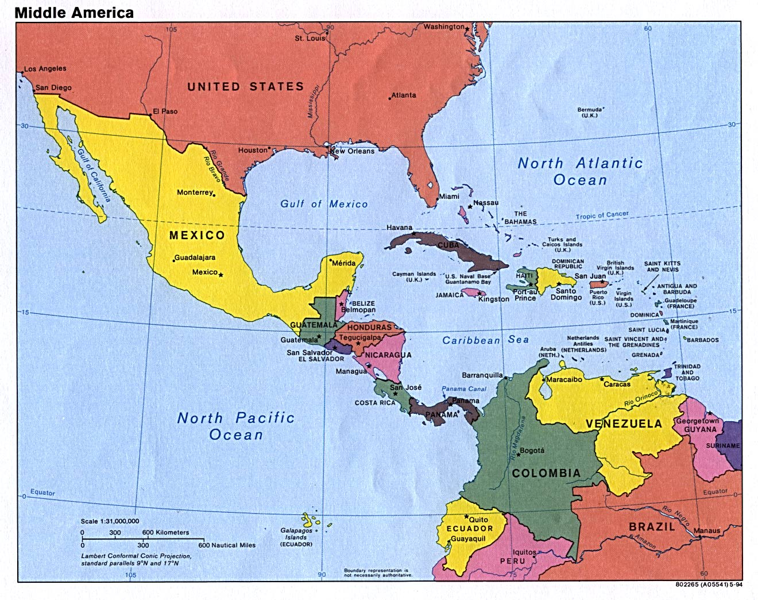
Wild Card 300
In which present day country did the Aztec’s live and prosper?
ANSWER: Mexico

Slide 25
Wild Card 400
If a person or a civilization only worship ONE god, they practice _____________.
ANSWER: Monotheism

Slide 26
Wild Card 500
Using your knowledge of where the Aztec Empire was located, what is one latitude/longitude coordinate that would be in their empire?
ANSWER: Vary

